Slide 1

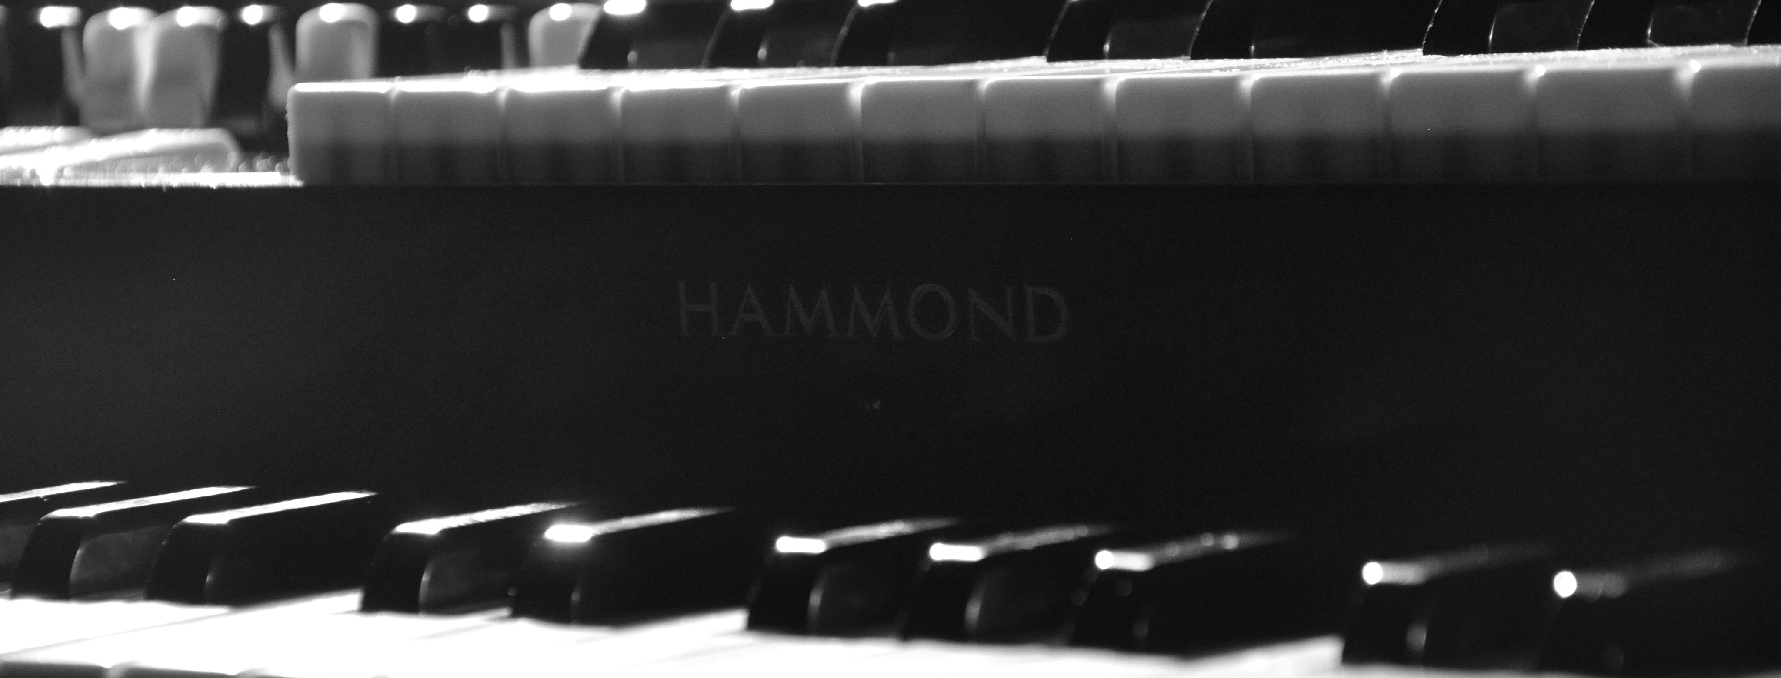
Keyboards In Worship
Old School | New School

Slide 2
Origins
Where Keyboards Come From and Where They’re Going

Slide 3


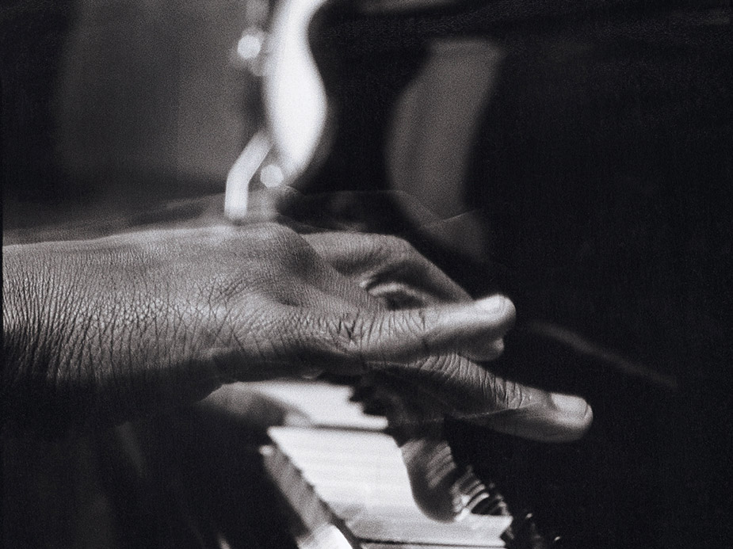
Piano
Origin: Harpsichord >> PianoForte>> Piano
Nature: Percussive with steady decay
Highly Dynamic
Broad tonal range (bright to mellow)
Huge Note Range
No expression after note is played
Examples: ‘Great Are You Lord’ from All Sons & Daughters, ‘I Need You Now’ Matt Redman

Slide 4

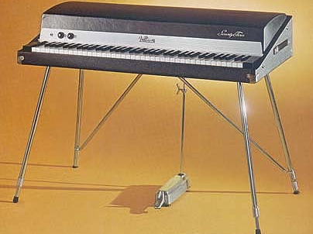
Rhodes
Origin: Piano >> Rhodes
Nature: Percussive with longer decay
Uses Magnetic Pickups like an Electric Guitar
Moderately Dynamic
Medium tonal range (from bell like to barking)
Limited Expression after note played
Example: ‘God’s Great Dance Floor’ - Chris Tomlin

Slide 5
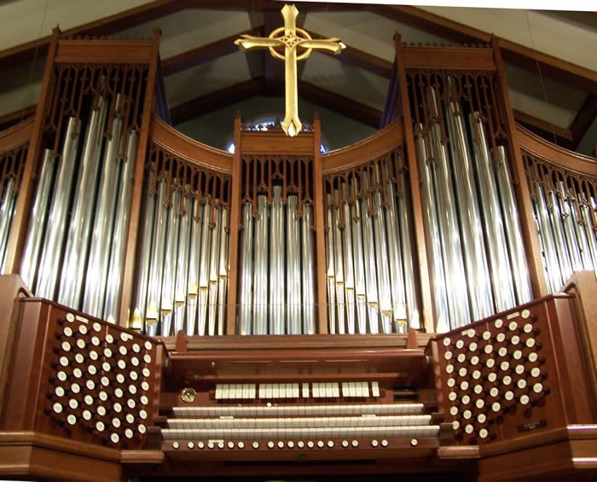
Pipe Organ (the first synth)
Origin: Wind Instruments
Nature: Sustain - Infinite
Highly Dynamic (through swell pedal and stops, not through velocity of key striking).
Extremely broad tonal range
Largest note range of all instruments
Volume expression after note is struck
Example: ‘Christ Arose’ - Aaron Doerr

Slide 6
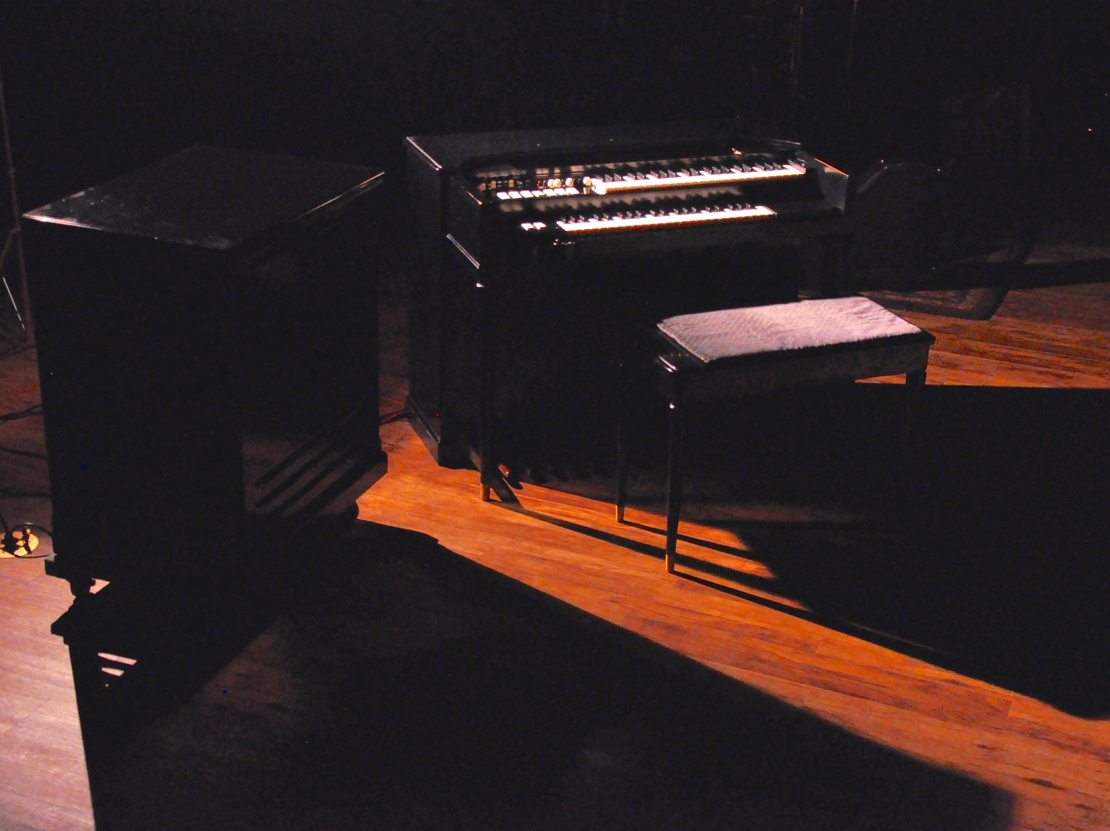
Hammond
Origin: Pipe Organ
Nature: Sustaining, but can have percussive elements too.
No dynamics through velocity of key strike, but has swell pedal and drawbars
Very expressive after note press through swell pedal, drawbars and Leslie speed switch
Examples: ‘Rising Sun’ from All Sons & Daughters, ‘Mighty To Save’ - Hillsong Wallflowers Bringing Down the Horse

Slide 7
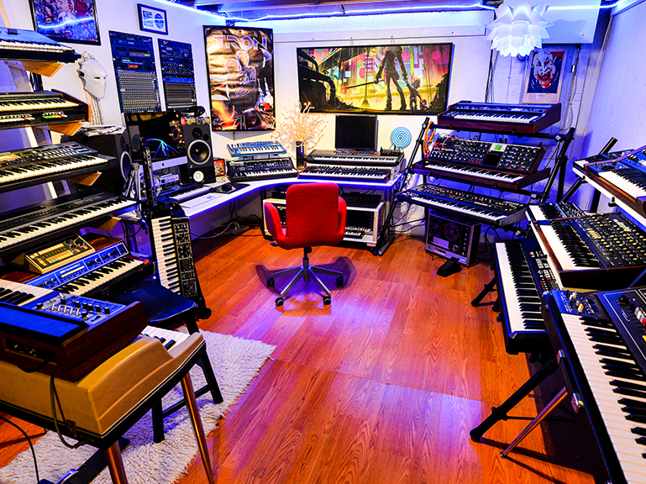
Synthesizer
Hardware and Software
Origin: Organs
Nature: Highly variable and customizable
Extreme Dynamic range
Extreme note range
Infinite expressive capabilities after note is played
Examples: ‘No One Like You’ - Jesus Culture, ‘Thank You Jesus’ - Hillsong Live, Tides Album from Bethel Music

Slide 8

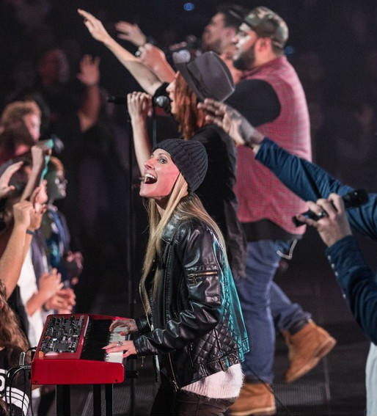
FOUR THINGS
SONG
PARTS
ROLE
RIG

Slide 9
Real Life Example
This Is Amazing Grace

Slide 10
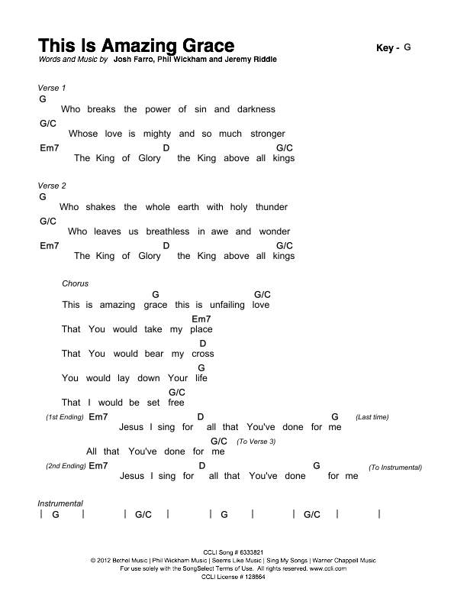
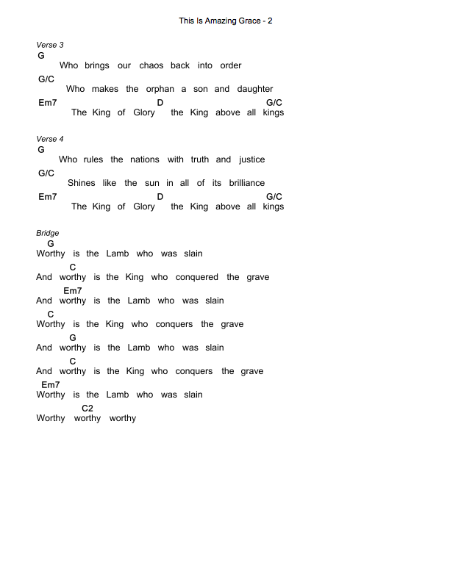
Delayed Comp w/leslie effect
Play Instrumental as intro:
CBAB,BAB,GABD-E-
CBAB,BAB,GABE-D-
Sync lead line
Synth lead line per recording
Stop!
Stop!
Synth Lead on intro

Slide 11
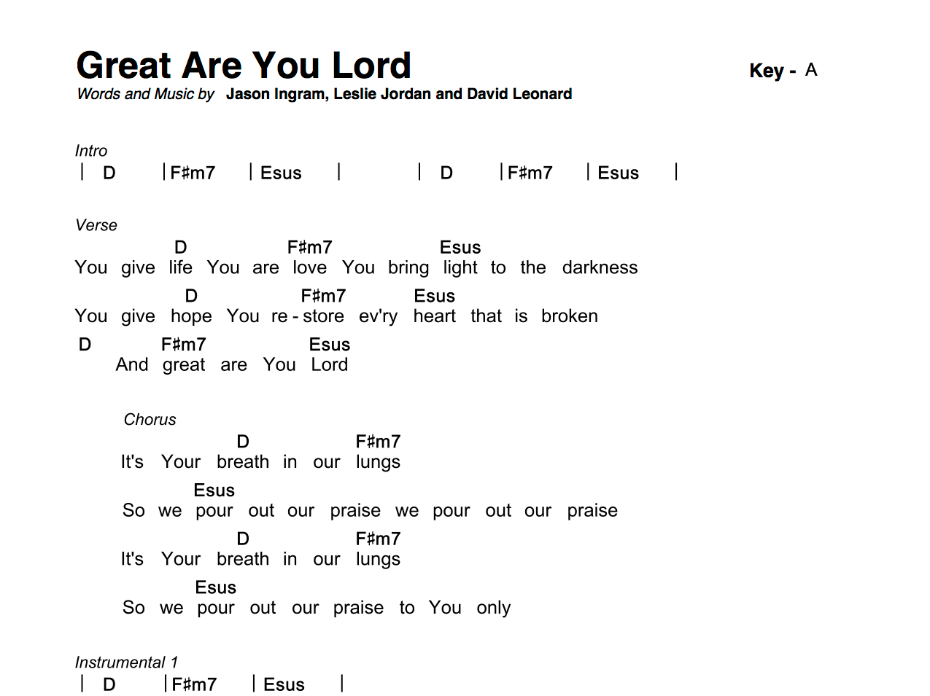
SONG
What is the song saying?
What emotion is the song conveying?
What is the tempo? (slow, fast, etc)
What is the groove? (driving, laid back, swing, straight)
What makes this song work?

Slide 12
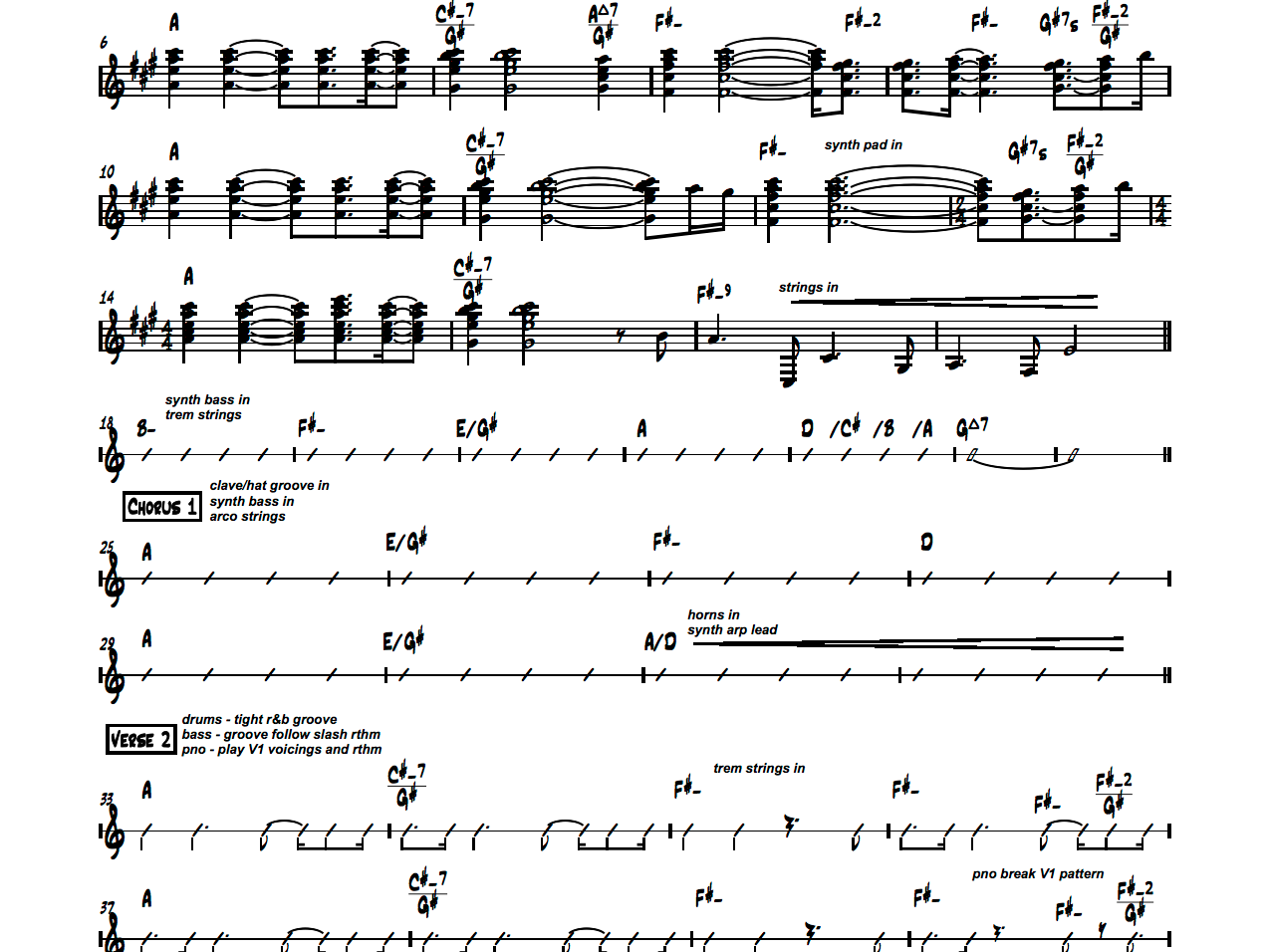
PARTS
What is my part in making the song work?
  What to play, what NOT to play.
What are the chords?
  Nashville Number System: 1,4,5,6m
What are the inversions/voicings?
  Pedal tones and voice leading
What are the lines, riffs, etc?

Slide 13
Nashville Number System
Each note in a western major scale has numbers from 1-7.
Each number can also be a chord (triad). 1, 4 and 5 are Major by default. 2, 3 and 6 are minor. 7 is diminished, but can often be substituted by playing a Major 5 triad with the 7th scale note in the bass.
If you learn the 1, 4, 5, and 6-minor in each key, you will be able to play 85% of all the songs you have in worship no matter what key they’re in.
Num | 1 | 2m | 3m | 4 | 5 | 6m | 7º
Key of C | C | Dm | Em | F | G | Am | Bº
Key of G | G | Am | Bm | C | D | Em | F#º

Slide 14
Voicings
Each triad (three note chord) has three positions you can play. Learn all three!
Be intentional about the top note of each chord you play because it is the most noticeable. You are either complimenting the melody or distracting from it with the top note of your chords.
Find inversions that minimize the amount of hand/finger movement.
Add a 2 or a M7 occasionally to add color of texture to a standard triad.

Slide 15
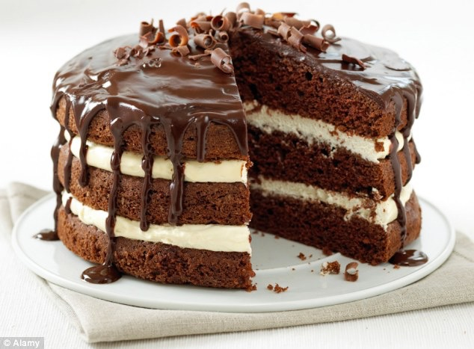
ROLE
Am I emulating another instrument or providing a sound unique to keyboards?
Am I providing rhythmic energy or sustaining energy? (Crunchy or Creamy)
Am I the main thing or a supporting role? (The Cake or the Frosting)

Slide 16
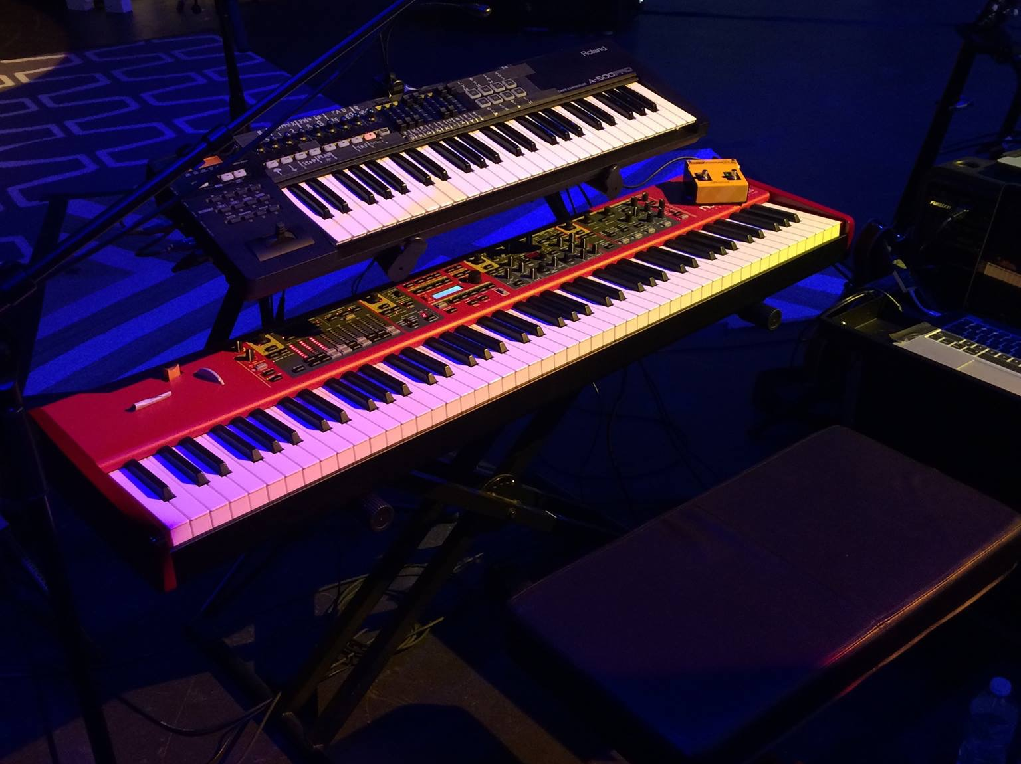
RIG
What can my rig do? (Hardware or Software)
What are the strengths of the sounds I have?
When do I use them?
Do I have my ‘go to’ sounds ready?
How do I play each sound? (Attack, velocity, controllers)

Slide 17

BONUS: YOUR LEFT HAND
Leave room for the Bass
See what happens if you stop using your left hand.
Give it a new job! (Mod Wheel and Leslie Switch)
Glisses, Smears and Smacks

Slide 18
Most Popular Synths
Yamaha Motif Series (H)
Nord Stage (H)
Korg Kronos (H)
Roland Fantom (H)
Omnisphere (S)
Reason (S)
Main Stage (S)
Massive (S)
Kontakt (S)

Slide 19
Resources
worshipmusicians.org (patches, tutorials, articles, tips, forums)
Hillsong Omnisphere Sounds - Facebook Group
facebook.com/groups/hillsongomnispheresounds/
multitracks.com (patches, tracks, good self-learning with custom mix)
peterjamesproductions.com
ianmcintosh.tv
MANUALS! - Google your manual, it’s out there.
YouTube.com
Forums (HarmonyCentral.com, motifator.com, korgforums.com, norduserforum.com

